Slide 1
Learning Objective
I will be able convert degrees to radians vice versa
Success Criteria
At the end of the lesson, I will be able to:
define radians as a unit of angle measurement

Slide 2

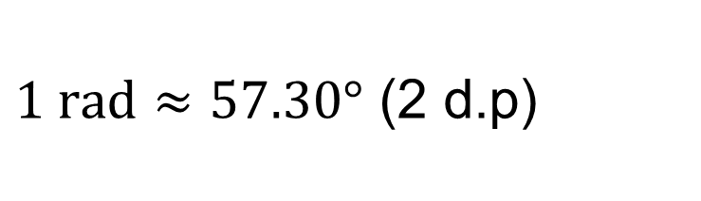

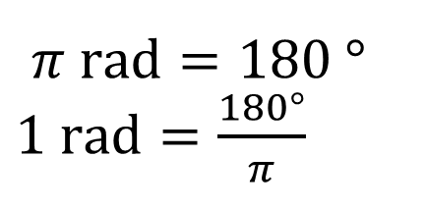
Angle measurement:
Concept Development
In Degrees - $θ°$
In Radians – radian, rad, $θ^{r}, θ^{c}$
$π \text{rad}=180 °$ $1 \text{rad}=\frac{180°}{π}$
(Exact form – leaving answers in terms of $π$)
$1 \text{rad}≈57.30°$ (2 d.p)

Slide 3
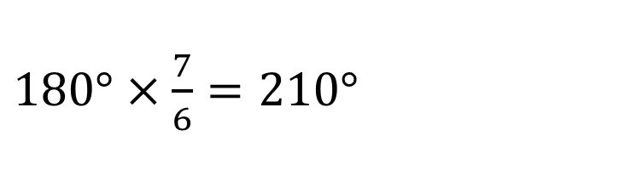


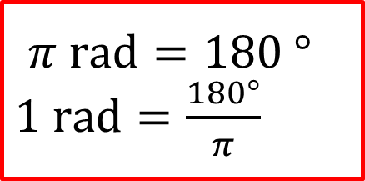



Skill Development
$π \text{rad}=180 °$ $1 \text{rad}=\frac{180°}{π}$
Convert Radian to Degree
$$2π \text{radian}\text{=}$$
$\text{360}°$
$$\frac{π}{2} \text{radian}\text{=}$$
$\text{90}°$
$$\frac{7π}{6} \text{radian}\text{= }$$
$180°×\frac{7}{6}=210°$

Slide 4




Skill Development
$π \text{rad}=180 °$ $1 \text{rad}=\frac{180°}{π}$
$$30°=$$
$$\frac{π}{180}×30=\frac{π}{6} \text{rad}$$
$$120°=$$
$$\frac{π}{180}×120=\frac{2π}{3}$$

Slide 5



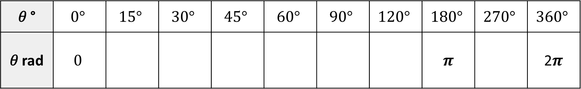




EXAMPLE 1: Complete the conversions table below for commonly used angles.
Guided Practice
𝜃 ° | $$0°$$ | $$15°$$ | $$30°$$ | $$45°$$ | $$60°$$ | $$90°$$ | $$120°$$ | $$180°$$ | $$270°$$ | $$360°$$
𝜃 rad | $$0$$ |  |  |  |  |  |  | 𝝅 |  | 2𝝅
$$\frac{π}{12}$$
$$\frac{π}{6}$$
$$\frac{π}{4}$$
$$\frac{π}{3}$$
$$\frac{π}{2}$$
$$\frac{2π}{3}$$
$$\frac{3π}{2}$$

Slide 6




EXAMPLE 2: Convert the following angles from degrees to radians. Answer exactly and to 2 decimal places.
Guided Practice
a) 20°
b) 110°
$$1°=\frac{π}{180} \\ 20°=\frac{20π}{180}=\frac{π}{9} \\ 20°≈0.35 rad$$
$$1°=\frac{π}{180} \\ 110°=\frac{110π}{180}=\frac{11π}{18} \\ 110°≈1.92 rad$$
c) 135°
d) 330°
$$1°=\frac{π}{180} \\ 135°=\frac{135π}{180}=\frac{3π}{4} \\ 135°≈2.36 rad$$
$$1°=\frac{π}{180} \\ 330°=\frac{330π}{180}=\frac{11π}{6} \\ 330°≈5.76 rad$$

Slide 7
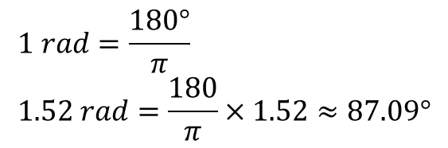





EXAMPLE 3: Convert the following angles from radians to degrees. Answer to 2 decimal places, where appropriate.
Guided Practice
a) $\frac{π}{3} rad$
b) ${\frac{5π}{6}}^{ }rad$
$$1 rad=\frac{180°}{π} \\ \frac{π}{3}rad=\frac{180}{π}×\frac{π}{3}=60°$$
$$1 rad=\frac{180°}{π} \\ \frac{5π}{6}rad=\frac{180}{π}×\frac{5π}{6}=150°$$
c) 3 rad
d) 1.52 rad
$$1 rad=\frac{180°}{π} \\ 3 rad=\frac{180}{π}×3≈171.90°$$
$$1 rad=\frac{180°}{π} \\ 1.52 rad=\frac{180}{π}×1.52≈87.09°$$

Slide 8

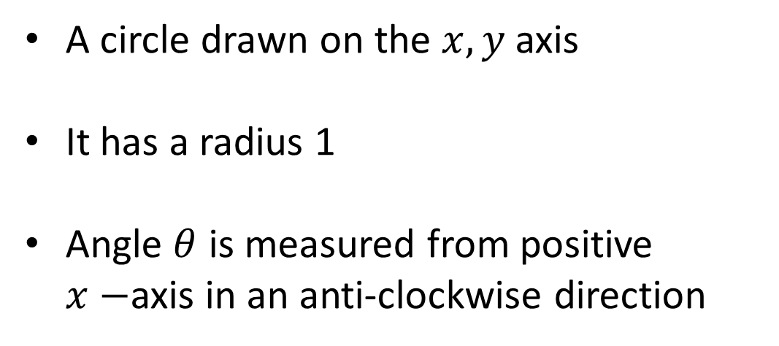


Concept Development
$$y$$
Unit Circle
1
A circle drawn on the $x, y$ axis
It has a radius 1
Angle $θ$ is measured from positive $x−$axis in an anti-clockwise direction
1
$$θ$$
1
0
1
$$x$$
1

Slide 9








Concept Development
Unit Circle
$$y$$
In the first quadrant, $0°≤θ≤90°$
Quadrant 2
Quadrant 1
1
Or $0≤θ≤\frac{π}{2}$ rad
In the second quadrant, $90°≤θ≤180°$
1
Or $\frac{π}{2}≤θ≤π$ rad
$$θ$$
In the third quadrant, $180°≤θ≤270°$
1
0
1
$$x$$
Or $π≤θ≤\frac{3π}{2}$ rad
In the forth quadrant, $270°≤θ≤360°$
Or $\frac{3π}{2}≤θ≤2π$ rad
Quadrant 3
1
Quadrant 4

Slide 10
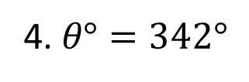
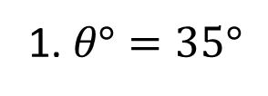
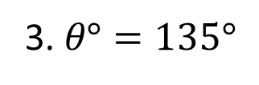
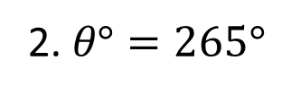
Guided Practice
Unit Circle
$$y$$
State the quadrant in which each of the following angles is found.
Quadrant 2
Quadrant 1
1. $θ°=35°$
Quadrant 1
2. $θ°=265°$
Quadrant 3
0
$$x$$
3. $θ°=135°$
Quadrant 2
4. $θ°=342°$
Quadrant 4
Quadrant 3
Quadrant 4

Slide 11
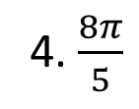
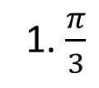
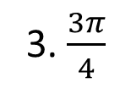
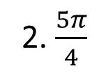
Guided Practice
Unit Circle
$$y$$
State the quadrant in which each of the following angles is found.
Quadrant 2
Quadrant 1
1. $\frac{π}{3}$
Quadrant 1
2. $\frac{5π}{4}$
Quadrant 3
0
$$x$$
3. $\frac{3π}{4}$
Quadrant 2
4. $\frac{8π}{5}$
Quadrant 4
Quadrant 3
Quadrant 4

Slide 12
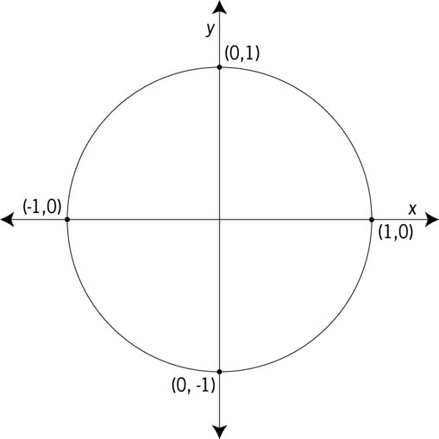

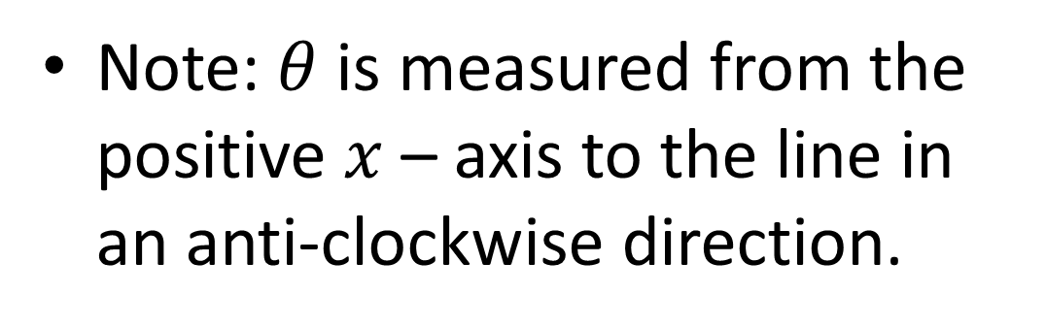


Concept Development
Unit Circle
Radius of circle = 1
$$(x,y)$$
Given $\left(x,y\right)$ and $θ$, we can find:
1
Cosine
$$θ$$
Sine
0
Note: $θ$ is measured from the positive $x$ – axis to the line in an anti-clockwise direction.

Slide 13
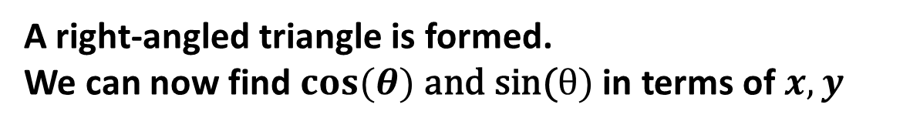


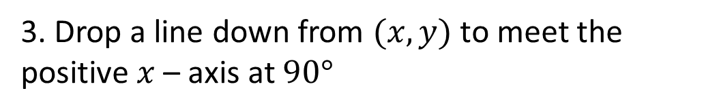

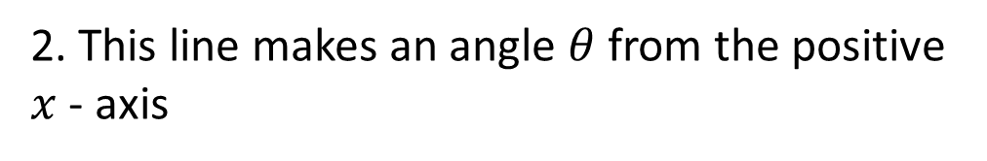

Concept Development
Unit Circle
If $(x,y)$ is a point on the unit circle,
$$(x,y)$$
1. Draw a line from the origin to the unit circle. The length of the line is 1.
1
$$y$$
2. This line makes an angle $θ$ from the positive $x$ - axis
$$θ$$
3. Drop a line down from $(x,y)$ to meet the positive $x$ – axis at $90°$
0
$$x$$
A right-angled triangle is formed.
We can now find $cos(θ) \text{and} \text{sin}\text{(}θ)$ in terms of $x,y$

Slide 14
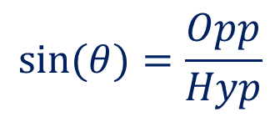

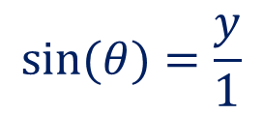

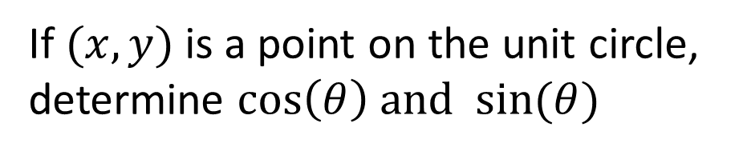

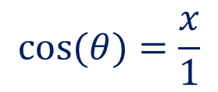
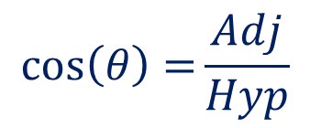
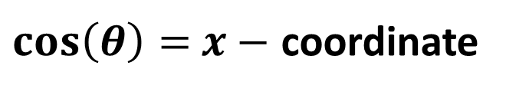
Concept Development
Unit Circle
If $(x,y)$ is a point on the unit circle, determine $\cos\left(θ\right) \text{and} sin⁡(θ)$
$$(x,y)$$
1
$$\cos\left(θ\right)=\frac{Adj}{Hyp}$$
$$\sin{(θ)}=\frac{Opp}{Hyp}$$
$$y$$
$$θ$$
0
$$x$$
$$\cos{(θ)}=\frac{x}{1}$$
$$\sin{(θ)}=\frac{y}{1}$$
$$\cos{(θ)}=x$$
$$\sin{(θ)}=y$$
$\cos\left(θ\right)=$ $x−$ coordinate
$\sin\left(θ\right)=$ $y−$ coordinate

Slide 15







Skill Development
Unit Circle
$$y$$
Determine $cos\left(θ\right)\text{, }\sin\left(θ\right)\text{when} θ=0 rad$.
Coordinates of $\left(x,y\right)=$ $(1,0)$
$$\left(x,y\right)=(\cos\left(θ\right),\sin\left(θ\right))$$
$$(x,y)$$
$$\cos{(0)}=1$$
$$\sin\left(0\right)=0$$
0
$$x$$

Slide 16
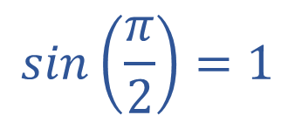




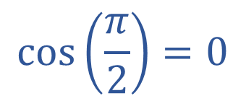
Skill Development
Unit Circle
$$y$$
Determine $cos\left(θ\right)\text{, }\sin\left(θ\right)\text{when} θ=\frac{π}{2}$.
$$(x,y)$$
Coordinates of $\left(x,y\right)=$ $(0,1)$
$$\left(x,y\right)=(\cos\left(θ\right),\sin\left(θ\right))$$
$$\frac{π}{2}$$
$$\cos\left(\frac{π}{2}\right)=0$$
$$sin\left(\frac{π}{2}\right)=1$$
0
$$x$$

Slide 17
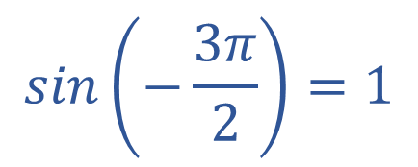
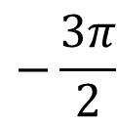
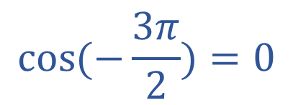
Skill Development
Unit Circle
$$y$$
Determine $cos\left(θ\right)\text{, }\sin\left(θ\right)\text{when} θ=−\frac{3π}{2}$.
$$(x,y)$$
Coordinates of $\left(x,y\right)=$ $(0,1)$
$$\left(x,y\right)=(\cos\left(θ\right),\sin\left(θ\right))$$
$$\cos{(−\frac{3π}{2})}=0$$
$$sin\left(−\frac{3π}{2}\right)=1$$
$$−\frac{3π}{2}$$
0
$$x$$

Slide 18
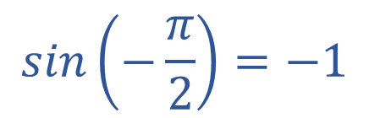


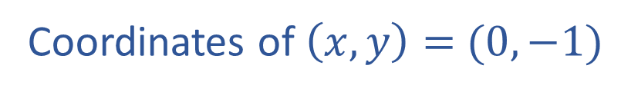
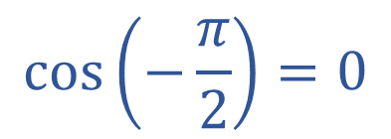
Skill Development
Unit Circle
$$y$$
Determine $cos\left(θ\right)\text{, }\sin\left(θ\right)\text{when} θ=−\frac{π}{2}$.
Coordinates of $\left(x,y\right)=$ $(0,−1)$
$$\left(x,y\right)=(\cos\left(θ\right),\sin\left(θ\right))$$
$$\cos\left(−\frac{π}{2}\right)=0$$
$$sin\left(−\frac{π}{2}\right)=−1$$
0
$$x$$
$$−\frac{π}{2}$$
$$(x,y)$$

Slide 19



Concept Development
Unit Circle
Adding $2π$ to the angle results in the same point
$$(x,y)$$
1
$$\cos{(2π+θ)}=\cos\left(θ\right)=x$$
$$y$$
$$θ$$
$$\sin\left(2π+θ\right)=\sin{(θ)}=y$$
0
$$x$$

Slide 20
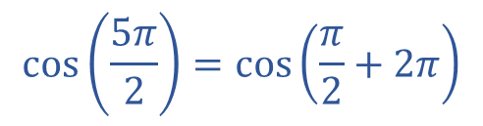

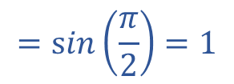



Skill Development
Unit Circle
$$y$$
Determine $cos\left(θ\right)\text{, }\sin\left(θ\right)\text{when} θ=\frac{5π}{2}$.
$$(x,y)$$
$$\cos\left(\frac{5π}{2}\right)=\cos\left(\frac{π}{2}+2π\right)$$
$$\frac{π}{2}$$
$$=\cos\left(\frac{π}{2}\right)=0$$
0
$$x$$
$$\sin\left(\frac{5π}{2}\right)=\sin\left(\frac{π}{2}+2π\right)$$
$$=\sin\left(\frac{π}{2}\right)=1$$

Slide 21






Skill Development
Unit Circle
$$y$$
Determine $cos\left(θ\right)\text{, }\sin\left(θ\right)\text{when} θ=27π$.
$$\cos\left(27π\right)=\cos\left(π+26π\right)$$
$$=\cos\left(π\right)=−1$$
$$(x,y)$$
$$π$$
0
$$x$$
$$\sin\left(27π\right)=\sin\left(π+26π\right)$$
$$=\sin\left(π\right)=0$$

Slide 22




Independent Practice
Complete Ex 12A and 12B
Don’t forget to change your calculators between degree and radians depending on the question.

